Slide 1



Statistical Analysis and Learning (SAL): Linear Regression (ISL Ch3, part 2) Textbook: An Introduction to Statistical Learning (ISL)
Varun Rai
LBJ School of Public Affairs
The University of Texas at Austin
7th February 2018

Slide 2
Note on Material
Unless otherwise noted, all material in this presentation are from this course’s textbook, An Introduction to Statistical Learning (ISL)

Slide 3
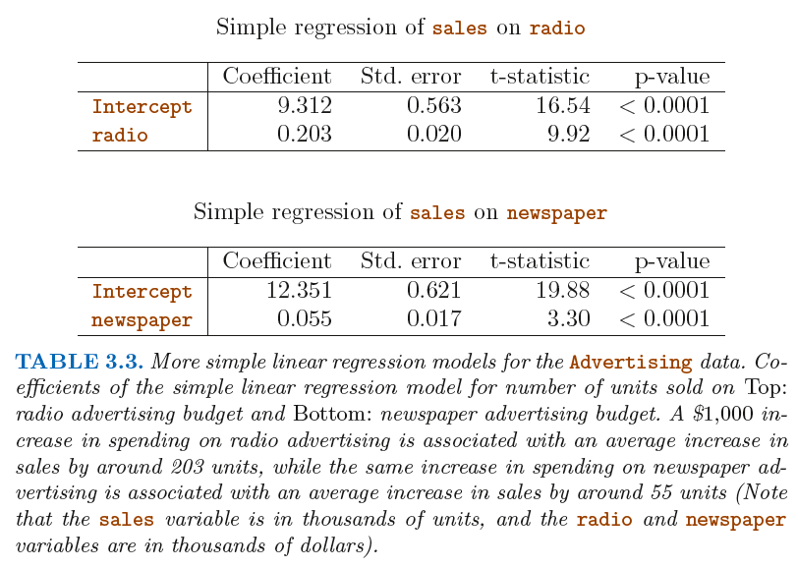
Multiple Linear Regression: More than 1 X

Slide 4
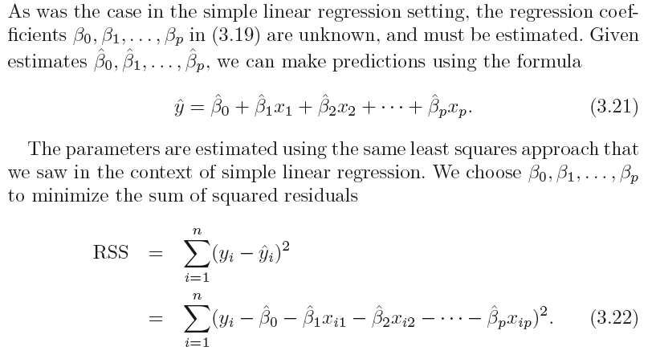
Estimating Coefficients in MLR
Notes:
Begin first session: 45min

Slide 5
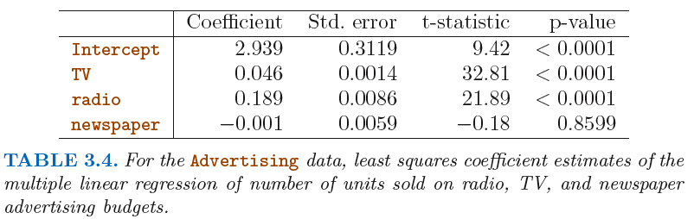
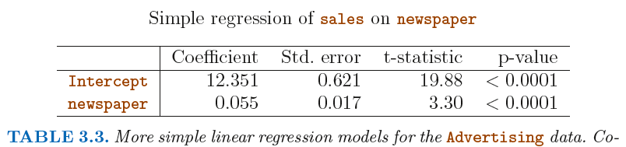
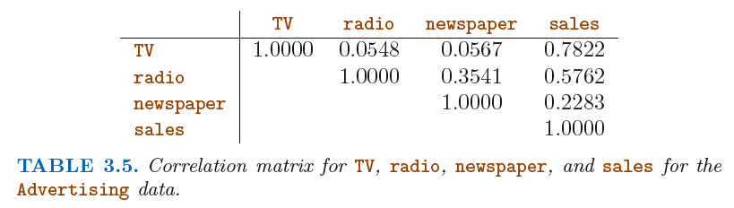
Multiple Linear Regression: Advertising

Slide 6
Some Important Questions in MLR
1. Is at least one of the predictors X1,X2, . . . , Xp useful in predicting the response?
Do all the predictors help to explain Y, or is only a subset of the predictors useful? (will skip now; covered in Chapter 6)
How well does the model fit the data?
4. Given a set of predictor values, what response value should we predict, and how accurate is our prediction?

Slide 7
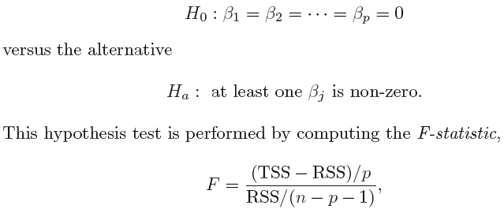


Is There a Relationship Between the Response and Predictors?
In the simple linear regression setting, in order to determine whether there is a relationship between the response and the predictor we can simply check whether β1 = 0. In the multiple regression setting with p predictors, we need to ask whether all of the regression coefficients are zero, i.e. whether β1 = β2 =...= βp = 0. As in the simple linear regression setting, we use a hypothesis test to answer this question. We test the null hypothesis,

Slide 8
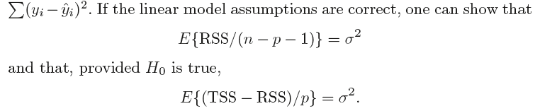
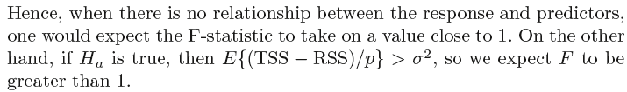
F Statistic

Slide 9
F Statistic
How large does the F-statistic need to be before we can reject H₀ and conclude that there is a relationship?
It turns out that the answer depends on the values of n and p .
When n is large, an F-statistic that is just a little larger than 1 might still provide evidence against H₀.
In contrast, a larger F-statistic is needed to reject H₀ if n is small.
When H₀ is true and the errors ε_{i} have a normal distribution, the F-statistic follows an F-distribution.
For any given value of n and p , any statistical software package can be used to compute the p-value associated with the F-statistic using this distribution.
Based on this p-value, we can determine whether or not to reject H₀.

Slide 10
Why calculate the F-Statistic? Is it not enough that the individual p-values for the β’s are (very) small?
NO!
Especially for large p, in which case just by chance one or more of the p-values might be very small, even if there is no true relationship between the predictor(s) and the response!
The F-statistic does not suffer from this problem because it adjusts for the number of predictors.
The approach of using an F-statistic to test for any association between the predictors and the response works when p is relatively small, and certainly small compared to n .

Slide 11
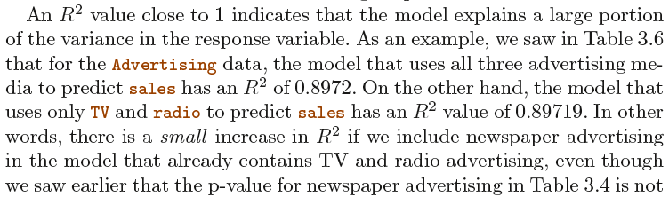
Model Fit in MLR
Two of the most common numerical measures of model fit are the RSE and R² , the fraction of variance explained. These quantities are computed and interpreted in the same fashion as for simple linear regression.
It turns out that R² will always increase when more variables are added to the model, even if those variables are only weakly associated with the response. WHY?

Slide 12
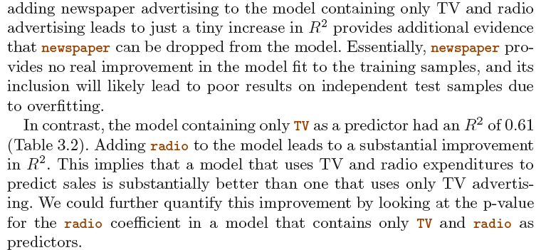

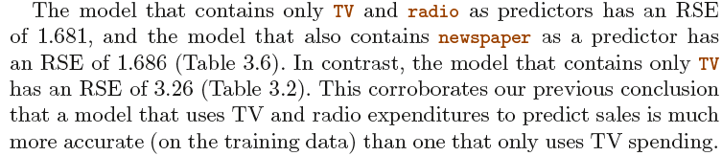
Model Fit in MLR: Advertising

Slide 13
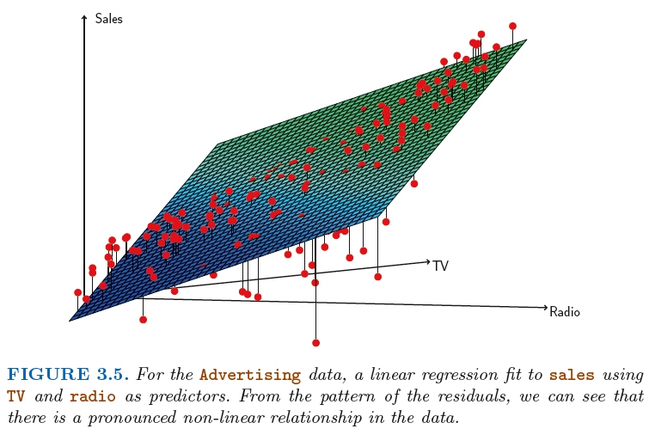
Model Fit in MLR: Visualizing the Errors

Slide 14

Predictions
Once we have fit the multiple regression model, it is straightforward to apply:
in order to predict the response Y on the basis of a set of values for the predictors X1,X2, . . . , Xp .
However, there are three sorts of uncertainty associated with this prediction:
Reducible error: sample vs. (true) population | use confidence interval
Model bias: linear model not good approx. for true f | Ignore now
Irreducible error: due to the random error term | use prediction interval
Prediction intervals are always wider than confidence intervals, because they incorporate both the error in the estimate for f (X ) (the reducible error) and the uncertainty as to how much an individual point will differ from the population regression plane (the irreducible error).

Slide 15
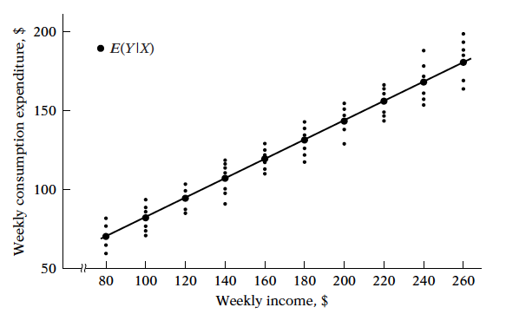

Back to Linear Regression for a Moment...
Source: Basic Econometrics, Gujarati, 5ed.
Notes:
Prediction: consider a company that is interested in conducting a
direct-marketing campaign. The goal is to identify individuals who will
respond positively to a mailing, based on observations of demographic variables
measured on each individual. In this case, the demographic variables
serve as predictors, and response to the marketing campaign (either positive
or negative) serves as the outcome. The company is not interested
in obtaining a deep understanding of the relationships between each individual
predictor and the response; instead, the company simply wants
an accurate model to predict the response using the predictors. This is an
example of modeling for prediction.

Slide 16
Confidence and Prediction Intervals
To estimate the uncertainty in our estimate of the conditional mean E(Y|X = x), we can construct a confidence interval for the conditional mean. But, as we have seen, the uncertainty in our estimate of Y when X = x is greater than our uncertainty of E(Y|X = x). Thus, the confidence interval for the conditional mean underestimates the uncertainty in our use of ŷ as an estimate of a value of Y|(X = x). Instead, we need what is called a prediction interval, which takes into account the variability in the conditional distribution Y|(X = x) as well as the uncertainty in our estimate of the conditional mean E(Y|(X = x).
Source: https://www.ma.utexas.edu/users/mks/statmistakes/CIvsPI.html

Slide 17
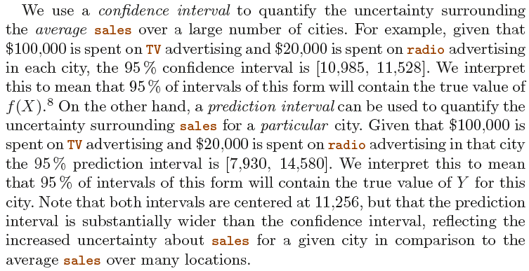
Confidence and Prediction Intervals
Notes:
End first session

Slide 18
Other Considerations in the Regression Model
Notes:
Begin second session: 45min

Slide 19
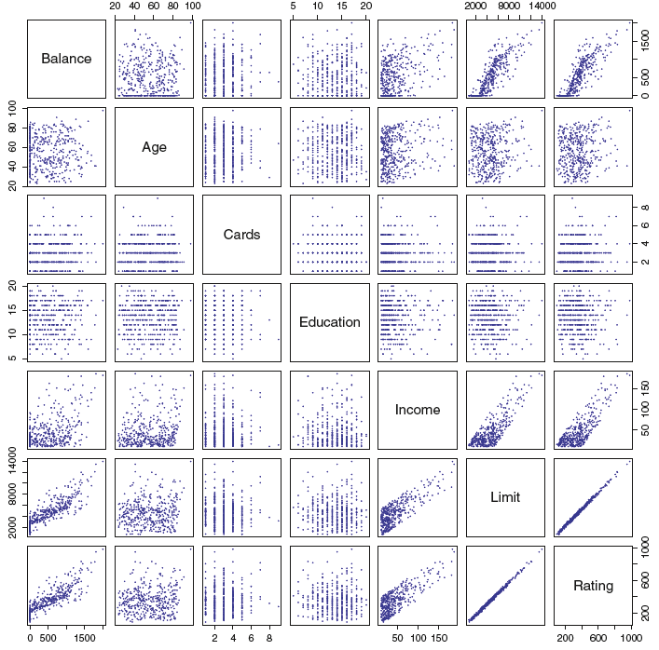
Qualitative Predictors
In addition to these quantitative variables, we also have four qualitative variables: gender , student (student status), status (marital status), and ethnicity (Caucasian, African American or Asian).

Slide 20
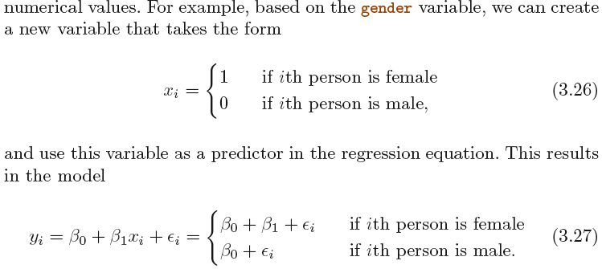
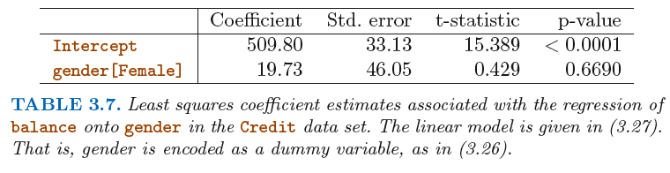
Predictors with Only Two Levels: Dummy Var.

Slide 21
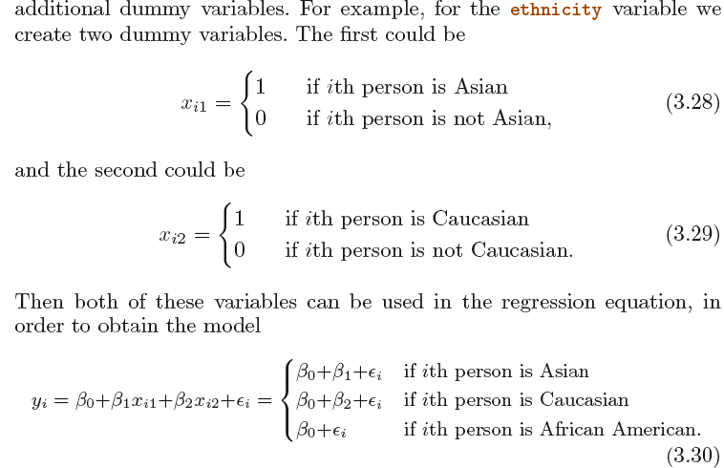
Qualitative Predictors with More than Two Levels

Slide 22
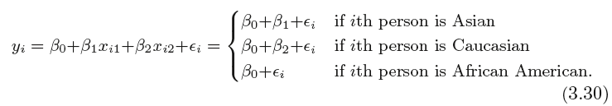
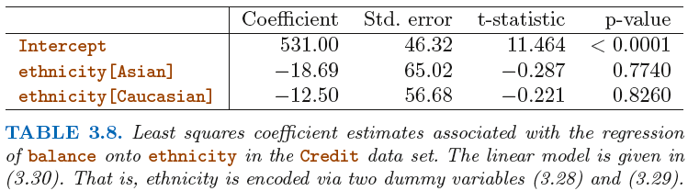
Qualitative Predictors with More than Two Levels

Slide 23
Extensions of the Linear Model
Two of the most important assumptions state that the relationship between the predictors and response are additive and linear.
The additive assumption means that the effect of changes in a predictor X_{j} on the response Y is independent of the values of the other predictors.
The linear assumption states that the change in the response Y due to a one-unit change in X_{j} is constant, regardless of the value of X_{j}.
In this course, we examine a number of sophisticated methods that relax these two assumptions. Here, we briefly examine some common classical approaches for extending the linear model.

Slide 24
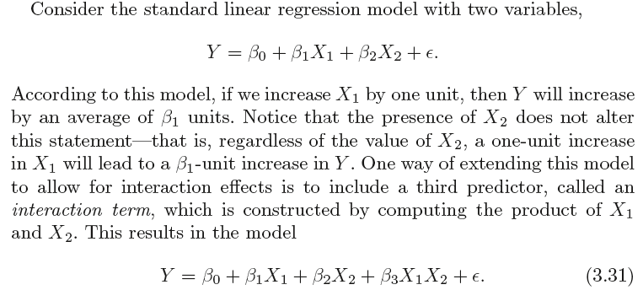
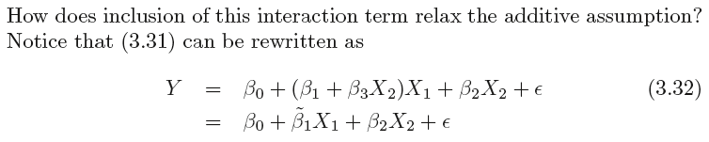
Removing the Additive Assumption

Slide 25
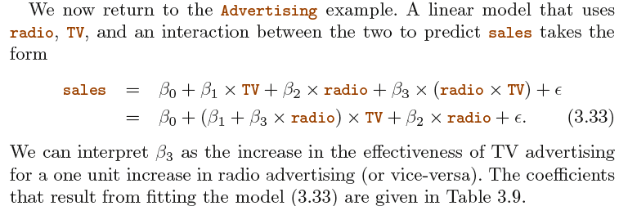
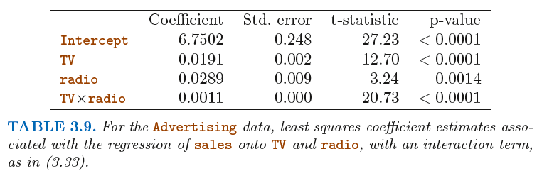
Removing the Additive Assumption: Adv.

Slide 26
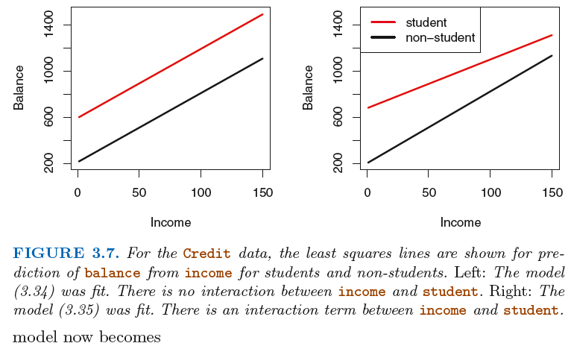
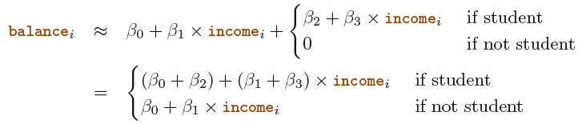
Interaction in the Case of Qualitative Vars.

Slide 27
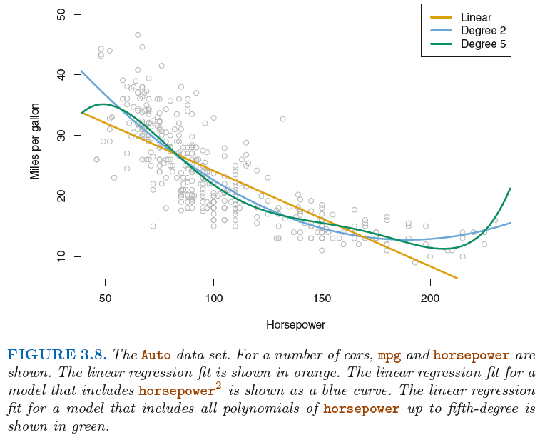
Non-Linear Relationships: Polynomial Reg.

Slide 28
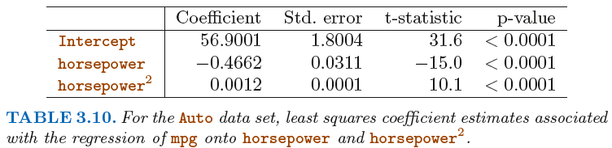
Non-Linear Relationships: Polynomial Reg.
Notes:
End second session

Slide 29
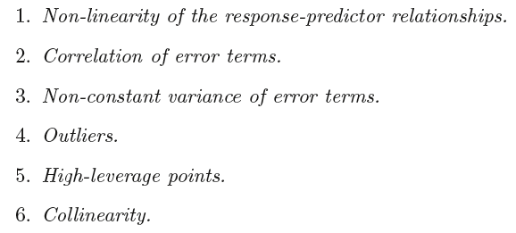
Potential Problems in MLR
Notes:
Begin third session: 60min

Slide 30
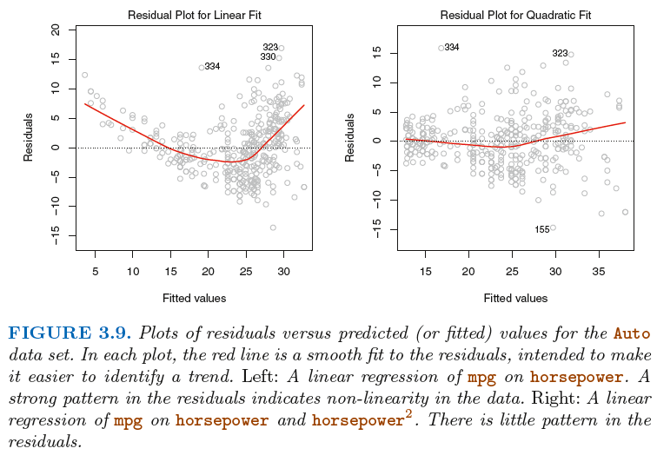
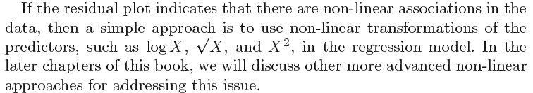
1. Non-linearity of the Data: Residual Plots

Slide 31
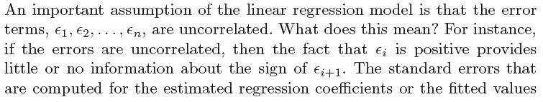
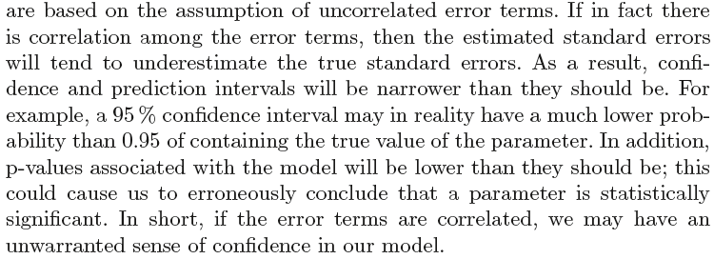
2. Correlation of Error Terms

Slide 32
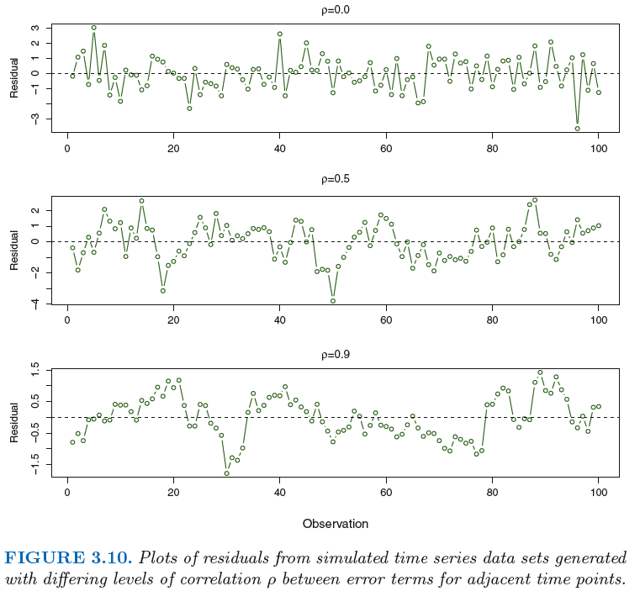
2. Correlation of Error Terms: Tracking

Slide 33
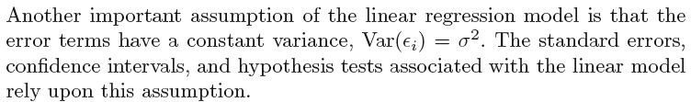
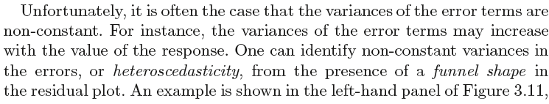
3. Non-Constant Variance of Error Term Heteroscedasticity

Slide 34
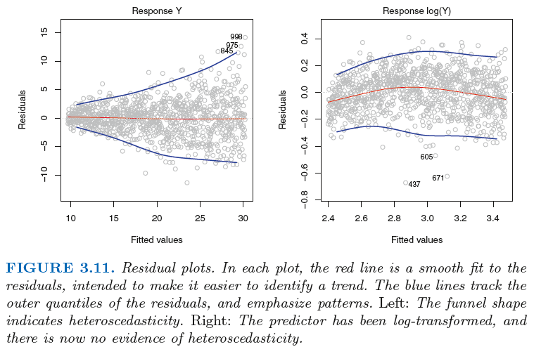
3. Non-Constant Variance of Error Term Heteroscedasticity

Slide 35

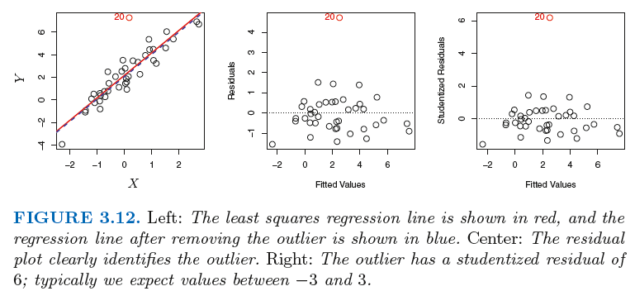
4. Outliers

Slide 36
4. Outliers
Plot the studentized residuals , computed by dividing each residual e_{i} by its estimated standard error. Observations whose studentized residuals are greater than 3 in absolute value are possible outliers.

Slide 37
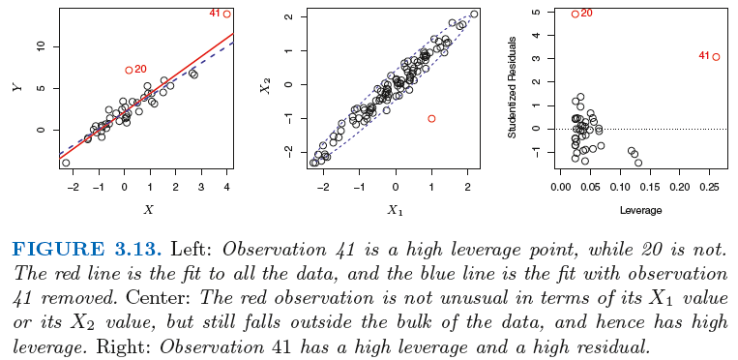

5. High Leverage Points
Observations with high leverage have an unusual value for x_{i} .
Leverage Statistic: The leverage statistic is always between 1/n and 1, and the average leverage for all the observations is always equal to (p +1)/n .

Slide 38
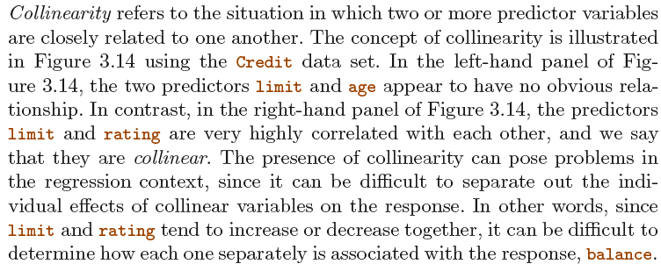
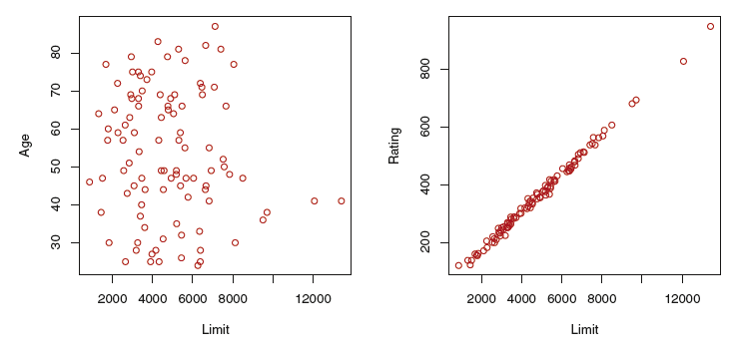
6. Collinearity

Slide 39
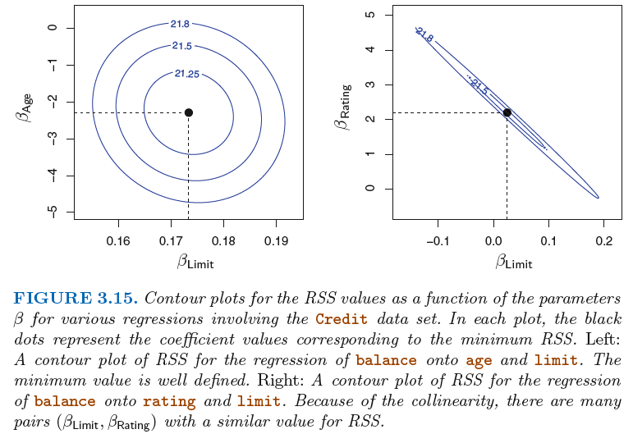
6. Collinearity

Slide 40
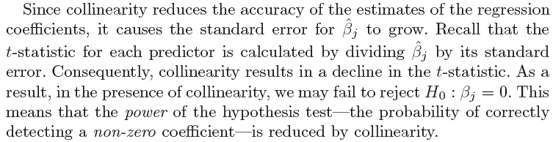
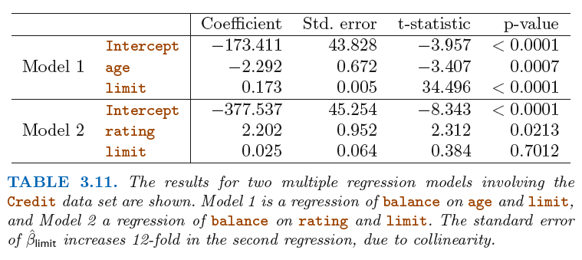
6. Collinearity

Slide 41
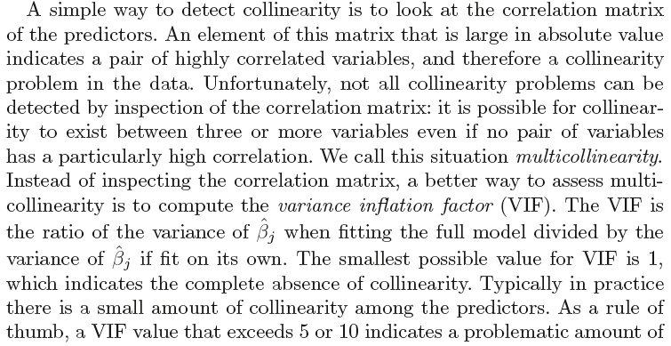
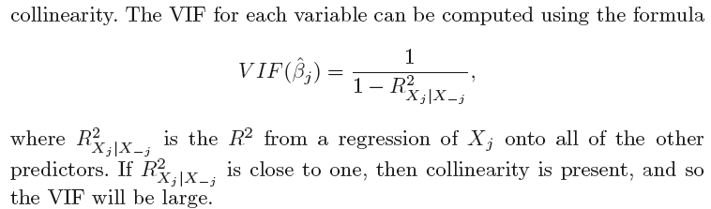
6. Collinearity

Slide 42
6. Collinearity: Two Simple “Solutions”
The first is to drop one of the problematic variables from the regression.
This can usually be done without much compromise to the regression fit, since the presence of collinearity implies that the information that this variable provides about the response is redundant in the presence of the other variables.
For instance, if we regress balance onto age and limit , without the rating predictor, then the resulting VIF values are close to the minimum possible value of 1, and the R² drops from 0. 754 to 0.75. So dropping rating from the set of predictors has effectively solved the collinearity problem without compromising the fit.
Can you think of any problem(s) with dropping a variable?
The second solution is to combine the collinear variables together into a single predictor. For instance, we might take the average of standardized versions of limit and rating in order to create a new variable that measures credit worthiness .

Slide 43
The Marketing Plan
Is there a relationship between advertising budget and sales?
F-statistic test, p-value very low
How strong is the relationship between advertising budget and sales?
RSE/Avg.Sales ~ 12%; R² ~ 90%
Which media contribute to sales?
p-value for TV and radio low; high for newspaper
How large is the effect of each medium on sales?
Range of the coefficient estimates. (Collinearity trouble for newspaper?)
How accurately can we predict future sales?
Check confidence and prediction intervals
Is the relationship linear?
No; check residual plot
Is there synergy among the advertising media?
Yes, between TV and radio; R² up from 90% to 97% w/ interaction
Notes:
End third session.

Slide 44

§3.5 KNN Regression: READING ASSIGNMENT

Slide 45
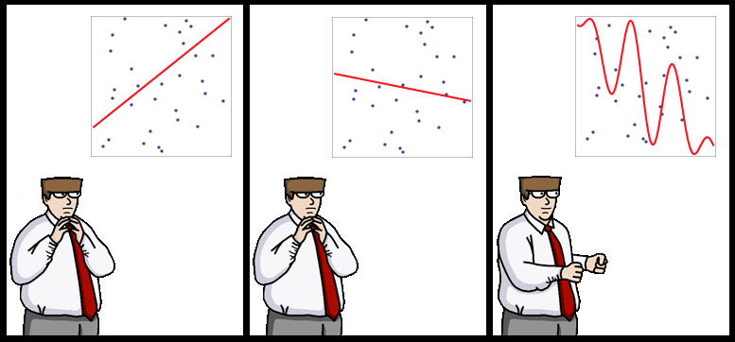
End of Lecture #4
Source: http://yaroslavvb.blogspot.com/

